Slide 1
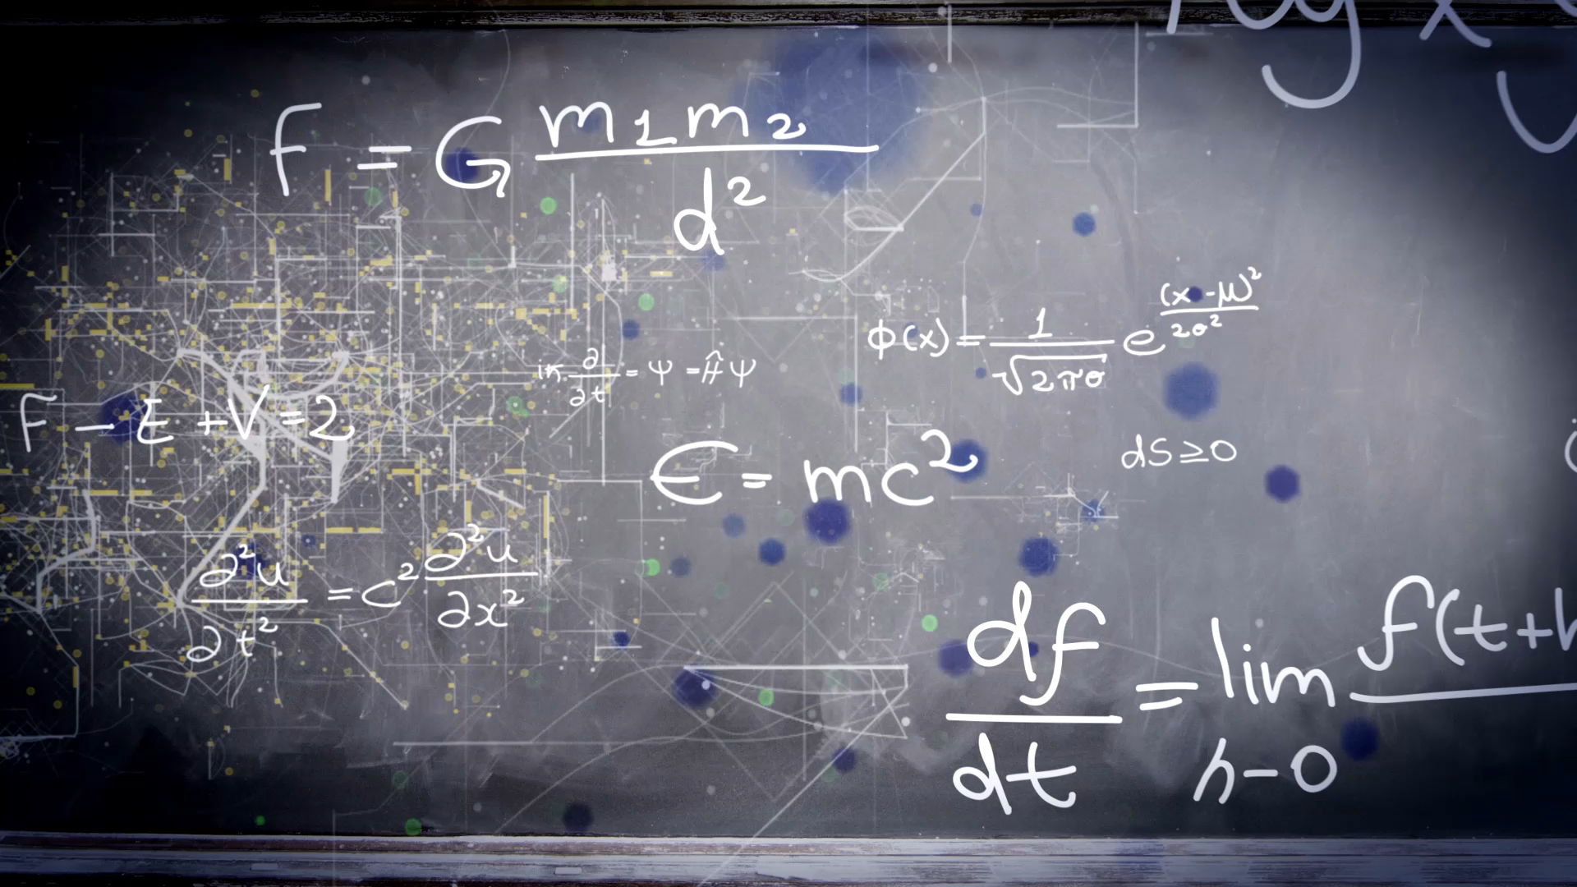
Project 2021
By Furkan AKŞiT, Sultan Melda İnat,
Abdullah Qureshi,
Şevin Akbulut

Slide 2

Methodology & Aim
Our methodology is to create the page that when user enters the site, they will see several categories for different moods. If user chooses one of them it will send the user to Youtube or Spotify podcasts webpage links that are linked with the several moods.
Our aim is to make sure you have a great week by recommending TV Series, documentaries, music, containing content suitable for your every mood.

Slide 3

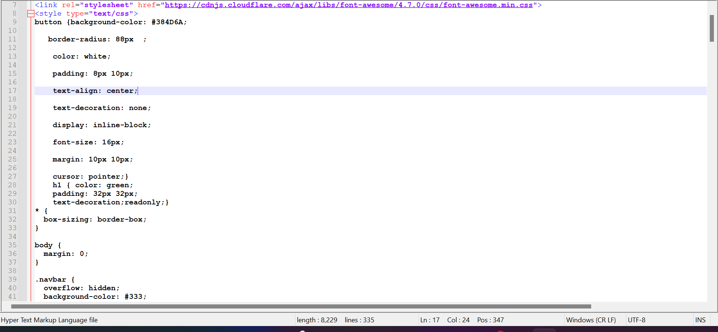
CSS
We used the inline CSS for our HTML webpage – Continued….

Slide 4
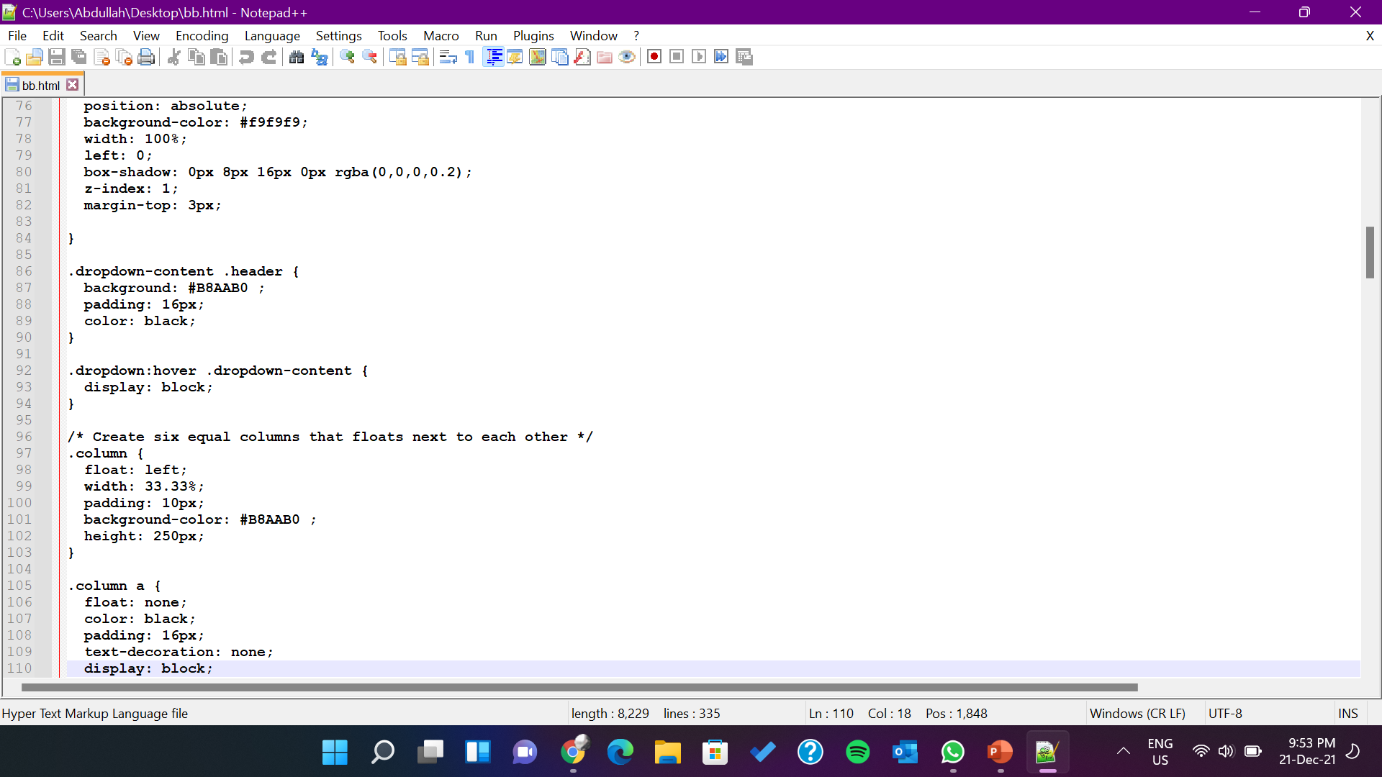
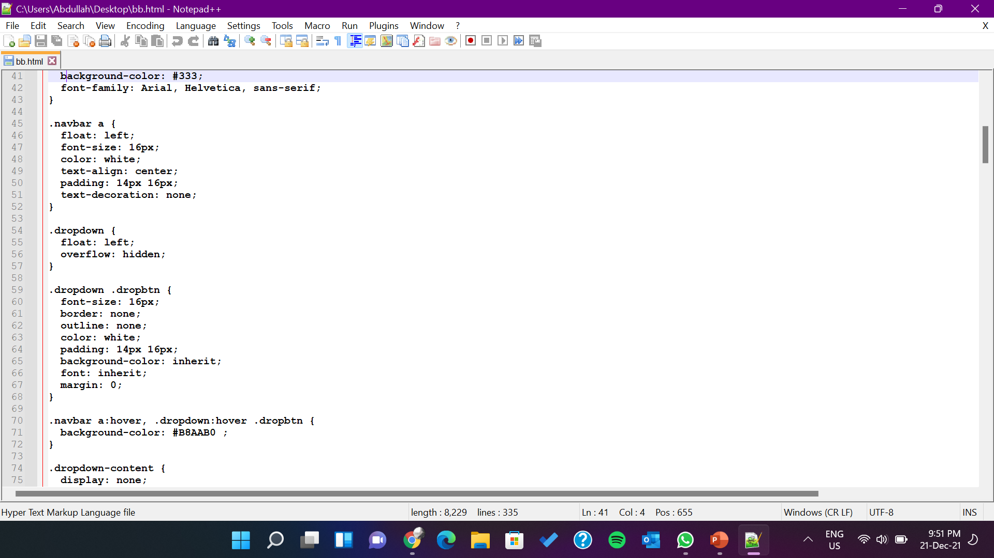
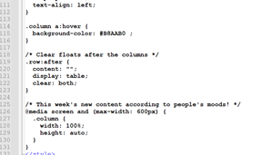
CSS Continued

Slide 5
HTML
body {
background: url(https://cdn.musicbed.com/image/upload/v1582214809/static/welcome/general/desktop-hero.jpg) no-repeat center center fixed;
-webkit-background-size: cover;
-moz-background-size: cover;
-o-background-size:
body{
background-image:url("mybackground.jpg")
background-size:contain;
background-repeat:no-repeat;
}

Slide 6
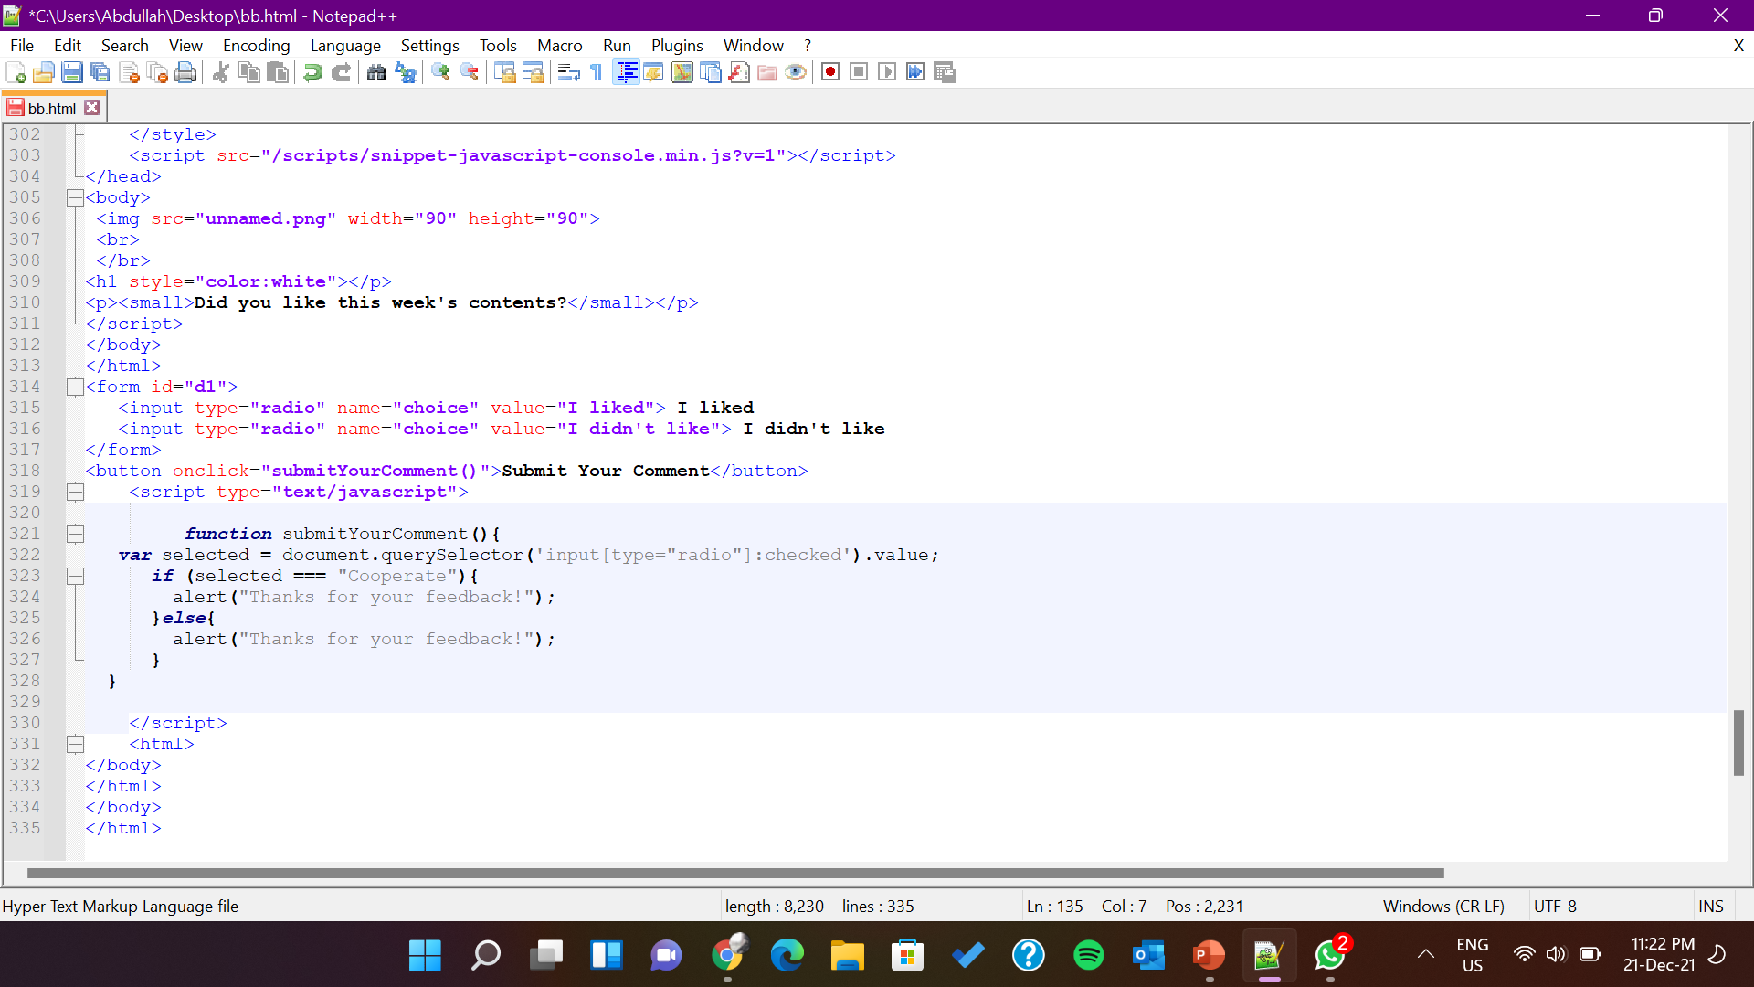
Javascript
This is the script we used for allowing user to send us their comments and suggestions by using the submit button.

Slide 7
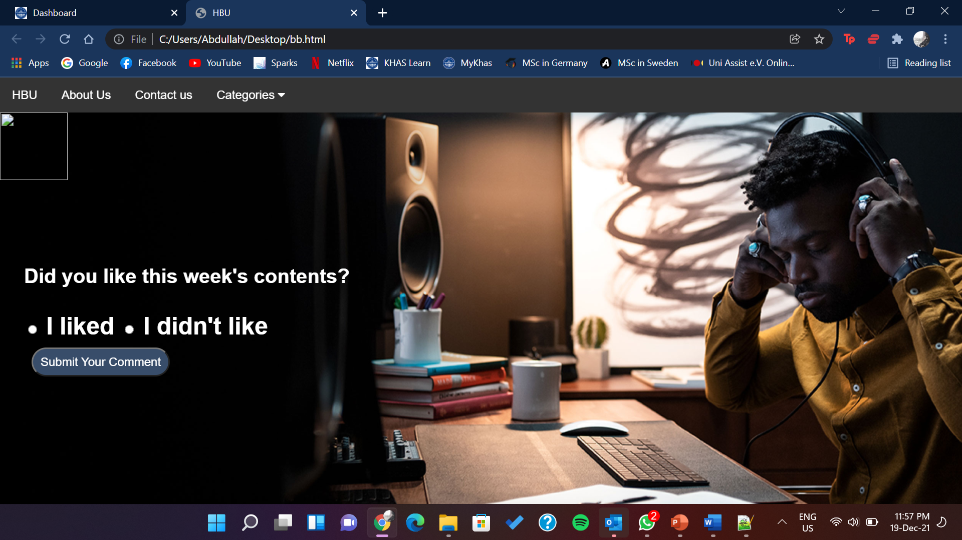
Home Page

Slide 8
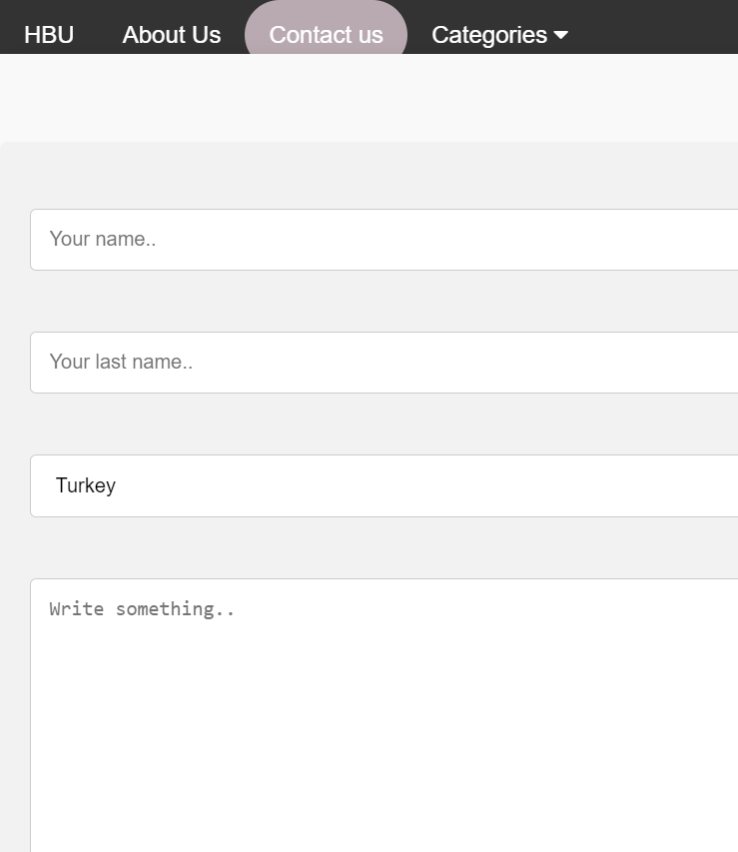
Contact us Page
Users have a contact page which they can use to reach us and give us their suggestions and views. With the help of those suggestions, we can make our users have a better webpage experience.

Slide 9
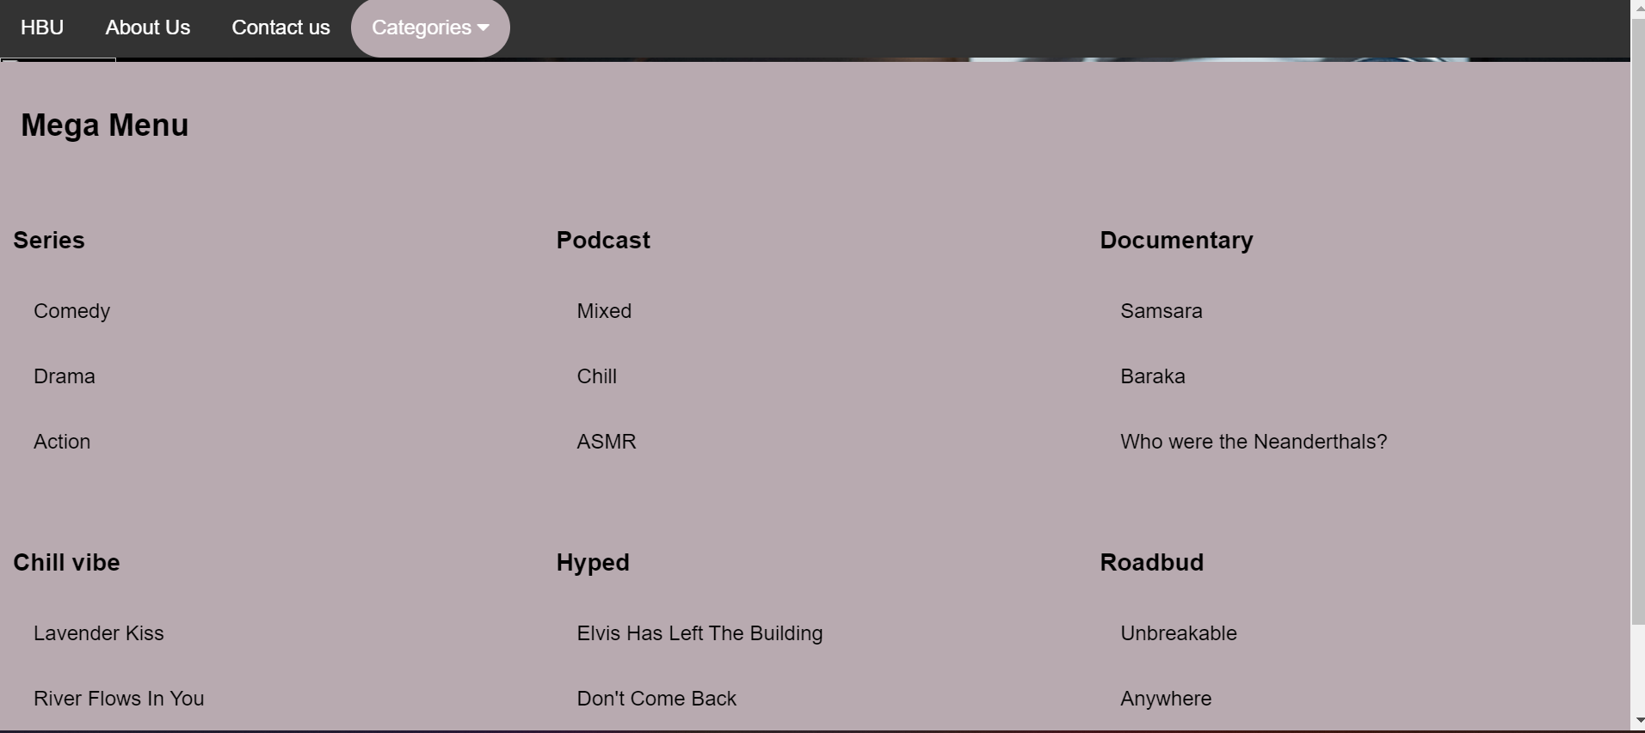
Categories Page
This is the categories page, which explains the several moods a person goes through in their daily life. Once you click on the desired mood, it will take you to either a youtube link or Spotify podcast.

Slide 10

Our Remarks
We will learn and stay up to date in trends In order to keep our website attractive.
The code will be refreshed every week if required.
We will hear the comments and suggestions from our users and try to implement them to our website.

Slide 11
Thank you for watching!
Any Questions?

